Slide 1


Technology Presentation
A Comparison of JavaScript Frameworks
By XAEA-XII

Slide 2


Slide 3
Learning Objectives
About jQuery
About Angular
About React
About Vue.JS
Comparison of these Frameworks listed above
Notes:
Light overview of each framework
Comparison of the frameworks
And run through some important information related to learning to use the framework and the appeal of learning the framework

Slide 4
Overview of Some JavaScript Frameworks
 | jQuery | Angular | React | VueJS
Initial Release | 2006 | 2010 | 2013 | 2014
Official Site | jquery.com | angular.io | reactjs.org | vuejs.org
Current Version | 3.5.x | 9 | 16.x | 2.6.x
Original Authors | John Resig | Google | Facebook | Evan You
Notes:
jQuery was created in 2006, by John Resig. It was designed to simplify DOM tree traversal and manipulation, as well as event handling, CSS Animation, and Ajax (asynchronous javascript and xml). With Ajax, web applications can send and retrieve data from a server asynchronously (in the background) without interfering with the display and behaviour of the existing page.
Angular was developed by Google, was first released in 2010. It is a TypeScript-based JavaScript framework.
React developed by Facebook, was initially released in 2013. Facebook uses React extensively in their products (Facebook, Instagram, and WhatsApp).
Vue is the youngest member of the group. It was developed by ex-Google employee Evan You in 2014. Over the last three years, Vue has seen a substantial shift in popularity, even though it doesn’t have the backing of a large company.

Slide 5

jQuery
Library for JavaScript
Lightweight: “Write Less, Do More”
Simplifies JavaScript Programming
Much easier to use JavaScript on websites
Easy to Learn
Companies using JQuery:
Uber
Twitter
Slack
Udemy
Notes:
jQuery is a library for JavaScript which simplifies Javascript programming, is easy to learn, and is still extremely popular.
The biggest difference between jQuery and other frameworks such as React is that jQuery manipulates the DOM directly, but manipulating the DOM directly is not the optimal development route. Because DOM elements carry around a lot of unnecessary data which make the performance go down when the web page is full of elements.
The virtual DOM is a DOM implementation in memory that compares to the existing DOM elements and makes the necessary changes/updates. And that leads to much faster performance.

Slide 6
JQuery Examples
Example 1:
$('#button1').click(function() { alert("Finish Project 4"); });
document.getElementById("button1").addEventListener('click', function(){ alert("Finish Project 4"); });
Example 2:
newDiv.classList.add('foo')
newDiv.addClass('foo')
Example 3:
$(this).attr(“id”)
this.id
JQuery was designed to resolve cross-browser issues
JQuery is a library, so there is always overhead

Slide 7

AngularJS
Distributed as a JavaScript file.
Can be added to a web page by using a script tag.
Extends HTML attributes and binds data to HTML.
ng-app directive defines an AngularJS application
<div ng-app="newApp"> ……. </div>
ng-model directive binds the value of an input field to a variable
Email:
<input type="email" name="myAddress" ng-model="text">
<span ng-show="myForm.myAddress.$error.email">Not a valid e-mail address</span>
ng-init directive initializes variables
<div ng-app="" ng-init="greeting='Hello!">
<h2> {{ greeting }} </h2>
ng-bind directive binds application data to HTML
Notes:
Angular is a platform and framework developed by Google for building single-page client applications using HTML and TypeScript. Angular is written in TypeScript. It implements core and optional functionality as a set of TypeScript libraries that you import into your apps.

Slide 8
AngularJS Expressions
Inside double braces: {{ expression }}.
Written inside a directive: ng-bind="expression".
<div> Hello, <span ng-bind="user.username"></span> </div>
<div> Hello, {{ user.username }} </div>
Similar to JavaScript expressions which contains literals, operations, and variables.
Notes:
AngularJS expressions can be written inside double braces
AngularJS expressions can also be written inside a directive
Ng-bind will be treated as an element attribute, so it will be invisible while the page is loading, {{ expression }} alternatively may be momentarily displayed before angular complies it
Double brace
AngularJS will resolve the expression, and return the result exactly where the expression is written.
AngularJS expressions are much like JavaScript expressions: They can contain literals, operators, and variables.
You can write expressions wherever you like, AngularJS will simply resolve the expression and return the result.

Slide 9
AngularJS Modules
Defines the application.
<div ng-app="newApp"> .... </div>
<script> var newapp = angular.module("newApp", []); ….. </script>
A container for the different parts of application.
A container for the application controllers.
Controllers always belong to different modules.
Notes:
Modules define the application, and act as a container for the different parts of the application.
Angular has its own modularity system called NgModules. NgModules are containers for a cohesive block of code dedicated to an application domain, a workflow, or a closely related set of capabilities. They can contain components, service providers, and other code files whose scope is defined by the containing NgModule.

Slide 10

React
A JavaScript library created by Facebook.
Makes it easier to create interactive user interfaces.
Updates and performs efficiently the correct parts when data changes.
Build components that manage their own state.
Notes:
React was created by Facebook in 2013.
It interacts with HTML documents via the so-called virtual DOM (which is a copy of the real DOM with all nodes represented as JavaScript objects) and follows a declarative style of programming. Its component-based approach gives you more speed and flexibility when building complex applications. Thus, it makes it easier to create interactive user interfaces.
A react application is made of multiple components, each responsible for rendering a small, reusable piece of HTML. Components can be nested within other components to allow complex applications to be built out of simple building blocks. A component may also maintain an internal state – for example, a TabList component may store a variable corresponding to the currently open tab.

Slide 11
DOM Render Example
<div id="hello">Hello World!</div>
<script type="text/babel">
ReactDOM.render(
<h1>Hello World!</h1>,
document.getElementById('hello'));
</script>
Notes:
The ReactDOM.render() function takes two arguments, HTML code and an HTML element.
The purpose of the function is to display the specified HTML code inside the specified HTML element.
It is used to render a React element into the DOM in the supplied container and return a reference to the component (or returns null for stateless components).
If the React element was previously rendered into the container, this will perform an update on it and only mutate the DOM as necessary to reflect the latest React element.
Also, ReactDOM.render() controls the contents of the container node you pass in.

Slide 12
React Elements and Components
Elements
Applications build around one HTML element.
Developers call that element the root element.
Example: const element = <h1>Hello xaea-xii!</h1>
They are immutable.
Components
JavaScript functions
Uses ES6 to make components.
Notes:
Elements are the smallest building blocks of React apps. An element describes what you want to see on the screen. Unlike browser DOM elements, React elements are plain objects, and are cheap to create. React DOM takes care of updating the DOM to match the React elements.
Components let you split the UI into independent, reusable pieces, and think about each piece in isolation. Conceptually, components are like JavaScript functions. They accept arbitrary inputs (called “props”) and return React elements describing what should appear on the screen.

Slide 13

VueJS
Can extend HTML with attributes.
Adds functionality to website applications.
Has built-in and user defined attributes.
Directives:
Uses double braces {{ }} to store data.
Prefix v-
Notes:
Vue is a progressive framework for building user interfaces. Vue is designed from the ground up to be incrementally adoptable. The core library is focused on the view layer only, and is easy to pick up and integrate with other libraries or existing projects.
The goal of Vue is to provide the benefits of reactive data binding and composable view components with an API that is as simple as possible.
Directives are prefixed with v- to indicate that they are special attributes provided by Vue, and they apply special reactive behavior to the rendered DOM.
Similar to React, the Component System is another important concept in Vue.
Again, it’s an abstraction that allows you to build large-scale applications composed of small, self-contained, and often reusable components.

Slide 14
Example
<h1 id=”application”>{{ message }}</h1>
<script>
var myObject = new Vue({
el: '#application',
data: {message: 'Hello xaea-xii!'}
})
</script>
Notes:
Here is a hello world example using Vue
At the core of Vue is a system that enables us to declaratively render data to the DOM using straightforward template syntax as seen in this example.
The data and DOM are now linked and everything is reactive.

Slide 15

Node.js
Generates dynamic webpage content
JavaScript could generate dynamic webpage content
HTML/CSS generates only static webpage content
Create, open, read, write, delete, and close files on the server
Collect data from completed forms
Add, delete, and update data in databases
Notes:
Node.js is a server-side platform built on Google Chrome's JavaScript Engine for easily building fast and scalable network applications. Node. js is primarily used for non-blocking, event-driven servers, due to its single-threaded nature. This makes it lightweight and efficient, perfect for data-intensive real-time applications that run across distributed devices.
It's used for traditional web sites and back-end API services, but was designed with real-time, push-based architectures in mind.

Slide 16
Node.js files
Have tasks that will be run on certain events
Initiated on the server before having any effect
Contains a .js extension

Slide 17
NPM
A package manager for Nodejs packages or other modules.
Hosed by www.npmjs.com
This program can be used by the following command
npm install
After successful installation, run the following
npm start
The JavaScript version of the set card game can use the electron framework.

Slide 18
Example
var http = require('http');
var uc = require('upper-case');
http.createServer(function (req, res) {
res.writeHead(200, {'Content-Type': 'text/html'});
res.write(uc.upperCase("Hello World!"));
res.end();
}).listen(8080);
Notes:
HELLO WORLD!

Slide 19
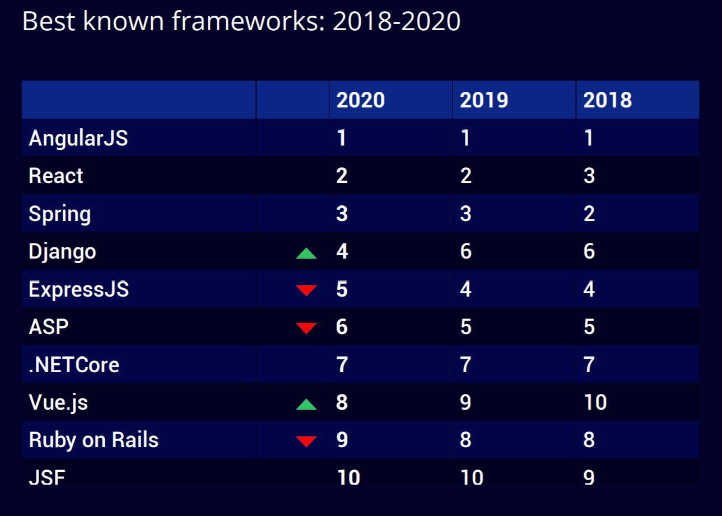
Overview of popularity of frameworks
Popularity of frameworks 2018-2020
Notes:
Hackerrank one of the most popular tech hiring platforms, has assembled extensive data about current trends in programming languages and frameworks.
Angular remains the best known framework since 2018, with React at a close second.
Vue has increased in use every year.

Slide 20

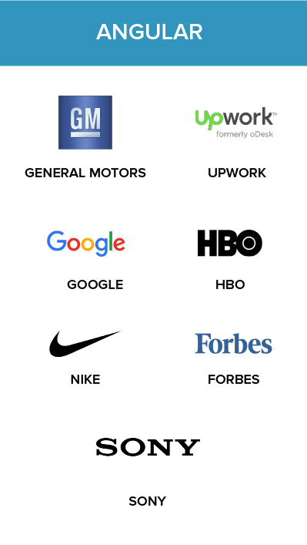
Vue:
168k github stars
3.1k commits
371 contributors
78k questions on Stackoverflow
851k live websites
React:
152k github stars
13.5k commits
1,480 contributors
231k questions on StackOverflow
1067k live websites
Angular:
68.3k github stars
19k commits
1,284 contributors
238k questions
968k live websites
Notes:
Vue = A smaller, but constantly growing community results in fewer resources.
React = A larger community and being maintained by Facebook results in a huge ecosystem of third-party libraries, packages, tools, and extensions as well as long-term support
Angular = The most mature of the three, with good backing in terms of contributors and is a complete package

Slide 21
Popularity and Support
Popularity
Determines the number of developers available for hire
The quality of third-party libraries
Most importantly, it means that someone out there has already solved the problems you might face in developing your project
Jquery - Declining in popularity
Stack overflow trends for jquery have been going down for 6 years
Its uses have been somewhat solved by vanilla JavaScript
However, due to its early release, it still one of the primary frameworks used on the internet today.
// jQuery
$('h1').text('Is this really that much better and worth the extra dependency?')
// Vanilla Javascript
document.querySelector('h1').textContent = 'Or is this pretty much equally good?'
Notes:
71% of the top 1 million websites are using jquery

Slide 22
Learning Curve
React:
Moderate learning curve
React offers a Getting Started guide to help set up React
Decent documentation
Angular:
Steep learning curve
Requires learning TypeScript and MVC
Vue:
Mild Learning Curve
Easy to transition to from React and Angular
Simple and Flexible
Notes:
React documentation is thorough, with a large amount of issues already present on stackoverflow. The learning curve for the core framework is not steep, but React is not a complete framework and advanced features require the use of third party libraries, so the learning curve for additional functionality varies. This also makes it difficult to follow best practices despite the ability to use react.
Angular: Has a steep learning curve because it is a complete solution and mastering angular requres learning typescript and MVC.
Despite the time it takes to learn Angular the result is a strong understanding of how the front end works.
Vue: Easiest to learn among the three. It’s functionality and use of components overlaps with Angular and react.
It is simple to use and flexible, but this advantage can backfire in terms of the resulting difficulty to debug and test code.

Slide 23
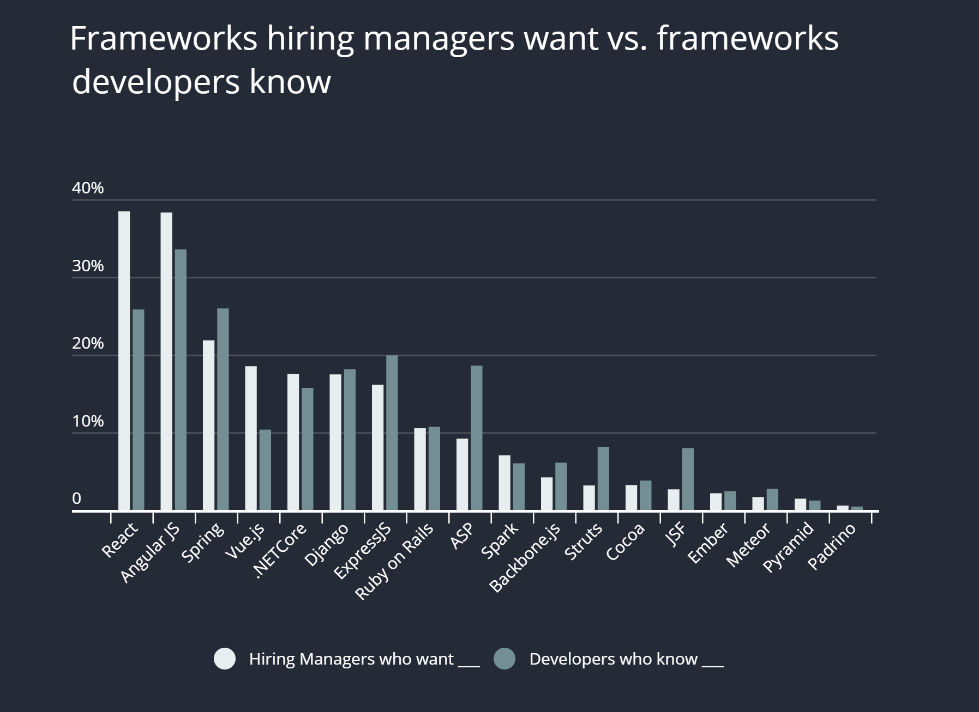
Talent Availability
Notes:
An important aspect to consider when using a framework is its appeal to companies looking to hire developers.
This data from 2019, shows that the increased interest in react is still outpaced by employer’s need for the front end framework.
React and vue are thus worthwhile investments as companies continue to need react and vue developers.

Slide 24
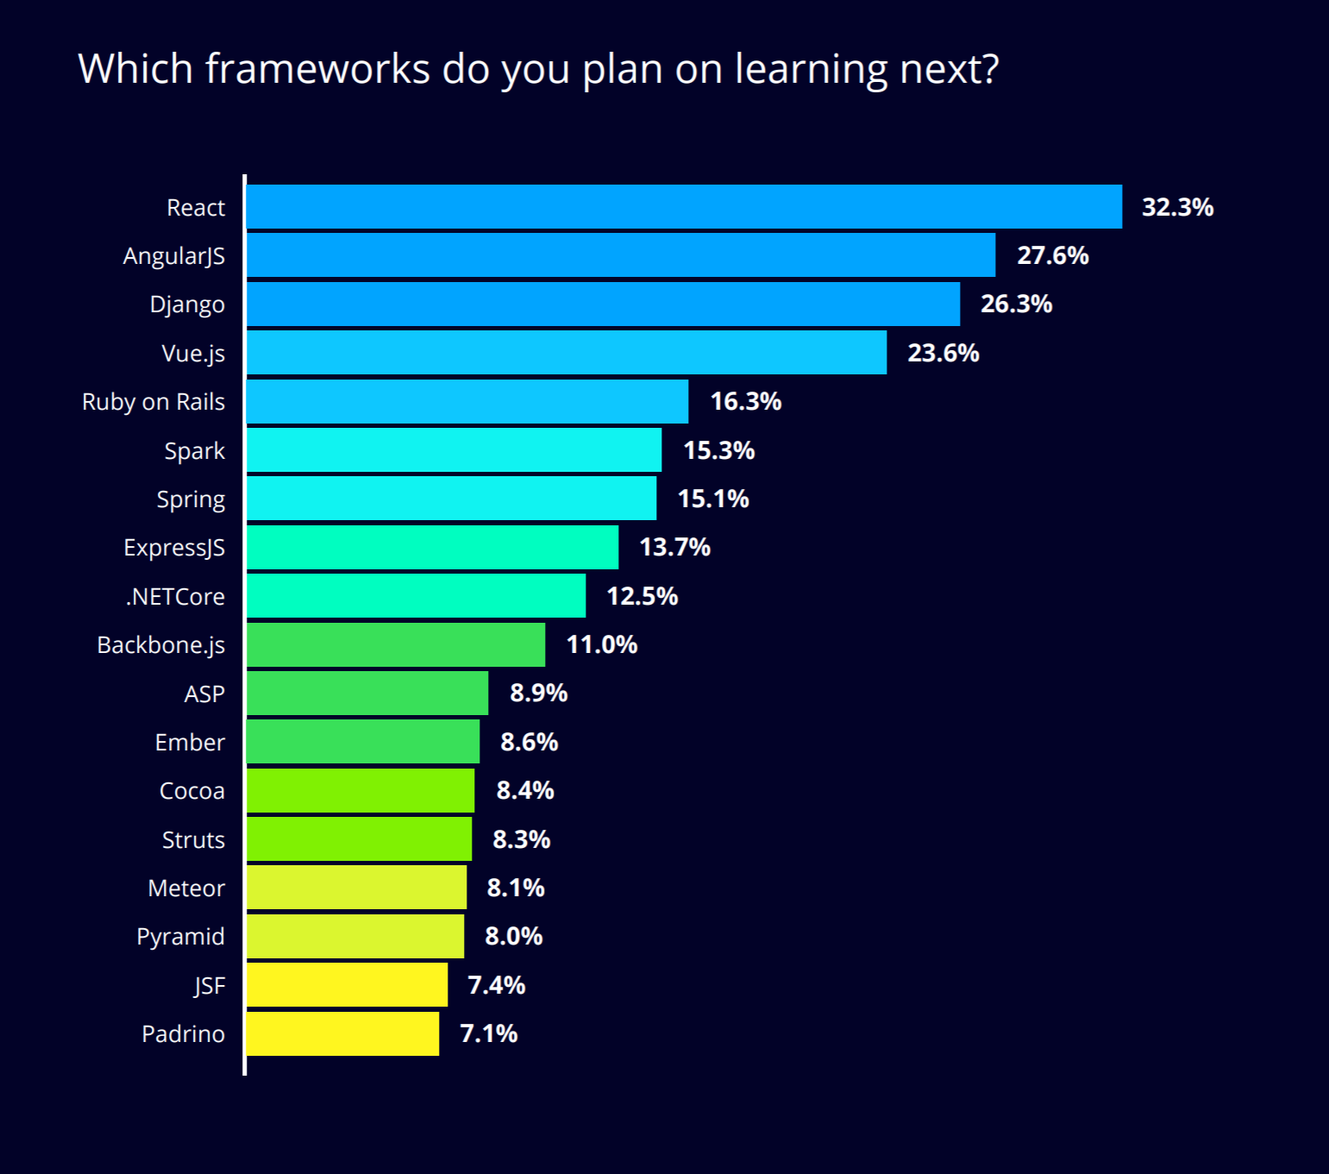
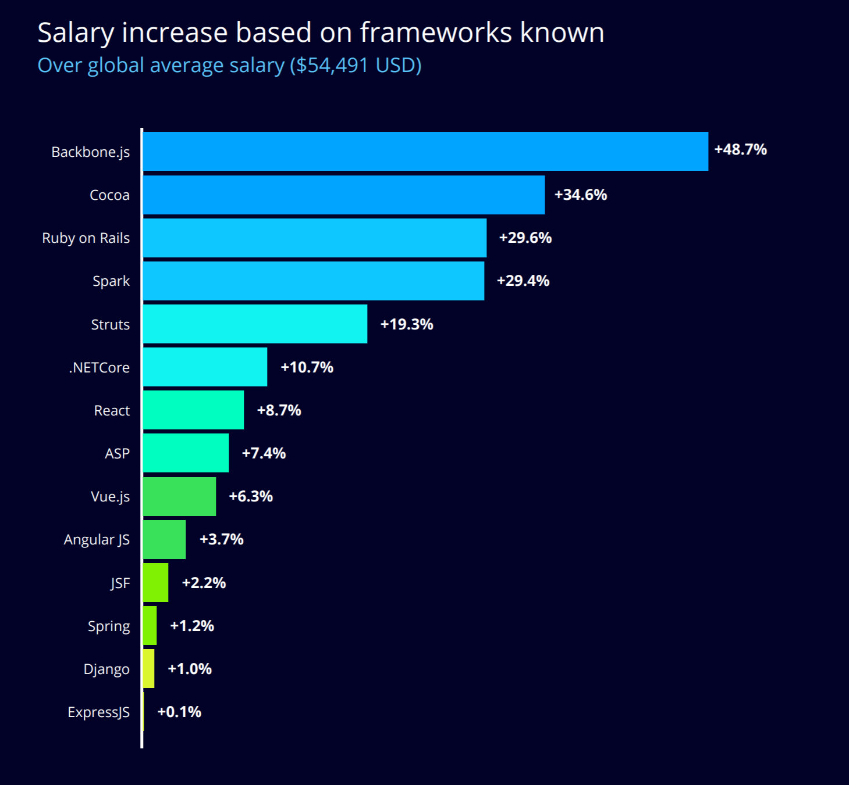
Talent Availability
Notes:
With the previous chart in mind, according to the hackerrank report, the chart on the left shows the frameworks developers plan to learn next this year.
Also, on the right the chart shows the salary increase for knowing various frameworks.
One of the most important forms of professional growth in the development world is learning new tech skills.

Slide 25
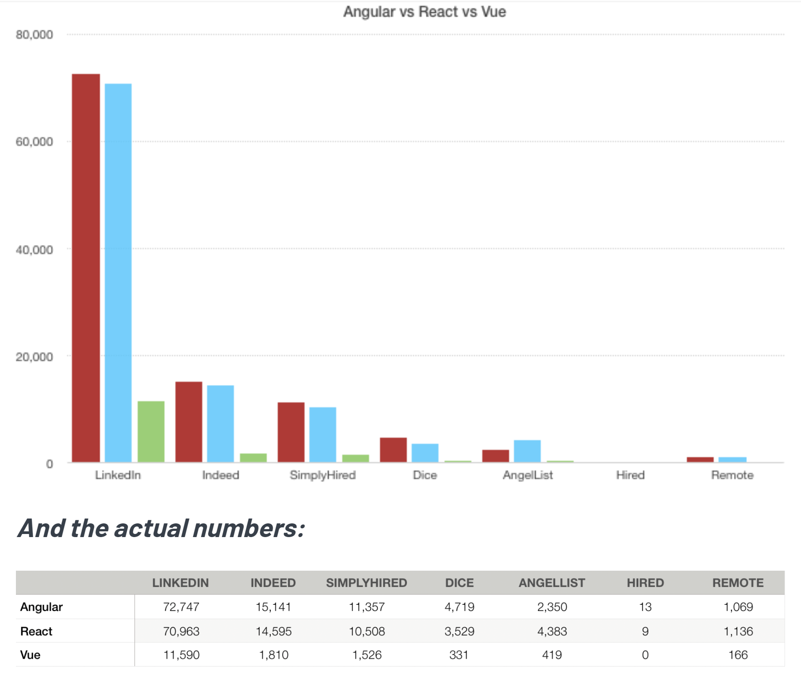
Job Opportunity
Angular
React
Vue
Notes:
As noted in the chart, employers continue to need developers who know react and vue.

Slide 26
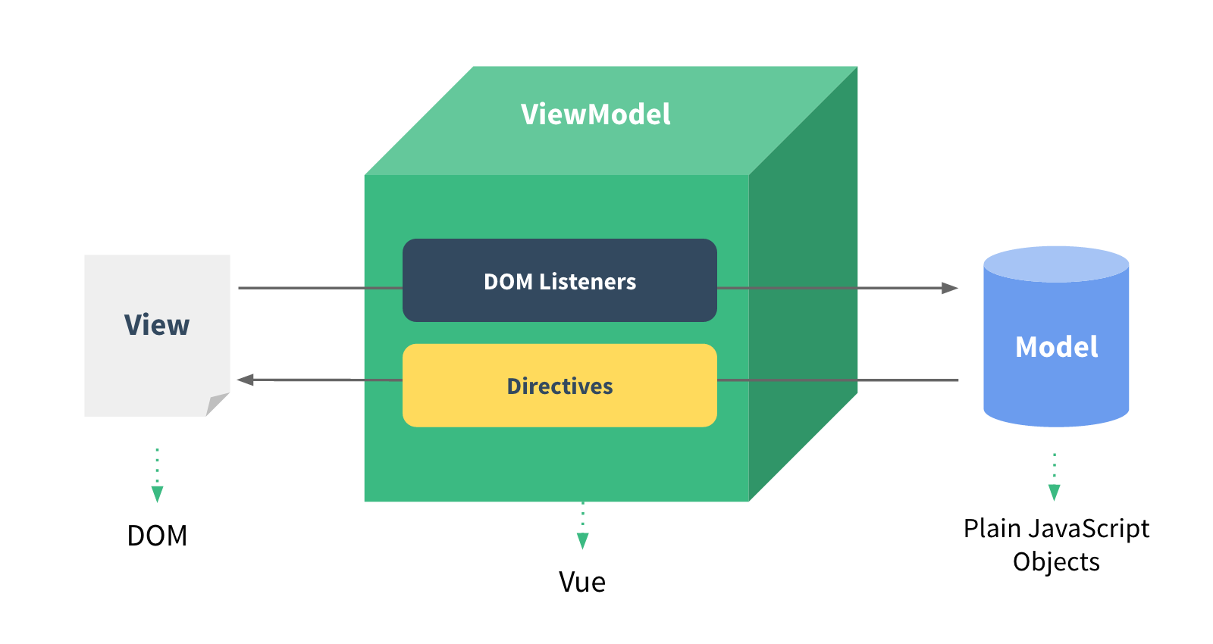
React Vs. Vue - Similarities
Virtual DOM - Both have virtual DOM’s to represent the UI synced with the “real” DOM
Reactive Data Binding - Both provide reactive view components
Performance - Both similarly (very) fast, but optimization is more reliant on the user in React
Scaling Up - Both provide a wide range of routing solutions and innovative state management
Notes:
Reactive Data-Binding - although React is two-way vs. Vue’s one-way databinding, they both are able to interact heavily between view and model as Vue’s one-way databinding handles the reactions for you
Performance - React has more intricate optimization, as you have to force objects not to re-render unnecessarily, Vue tracks dependencies so it knows what needs to be rendered automatically
Scaling Up - React leaves state management control libraries up to the community (producing Flux/Redux), which being larger than Vue’s keeps it updated. Vue has its state management libraries within its core library and its officially supported by the team (Vuex). Vue also has a much better command line project generator, but React is actively working to improve on more application templates and allowing for user-built presets.
Data Binding.

Slide 27
React vs. Vue - Differences
React
Vue
JavaScript only
All components and styling usually done within JSX or JS.
Basic Overview
Provides basics of React development, but not as well put together.
Reliant on External Solutions
Needs an external library (Flux/Redux) for state management/routing.
Varying Templates
Provides render functions and JSX, but also accepts HTML among other templates. CSS has style tags
Thorough and easy to follow
Very clear and simple to create Vue applications. More clear answers.
Standalone Framework
Fewer companion libraries due to its vast functionality in the core library.
UI
Documentation
Independence
Notes:
JSX - A declarative XML-like syntax within JavaScript. The CSS is done using component-oriented-styling. Vue’s style tags provide access to CSS in the same file as the component
Documentation - Both are translated into a wide variety of languages, but React’s documentation is a lot less complete than Vue’s. Vue has well-written and accessible documentation/API for anyone to create Vue applications. Another thing to note is how opinionated Vue is, as people have much clearer answeres to FAQ’s in Vue’s documentation.
Independence - React requires some external solutions like flux and redux listed from the start for routing and state management. Vue works well on its on in simple applications, only needing external solutins such as Vuex for larger applications.

Slide 28
Documentation
Vue has great docs, which provide clear answers for issues
Vue’s API references are one of the best in industry
Both React and Vue have docs translated into several languages
Notes:
The React documentation assumes some familiarity with programming in the JavaScript language. You don’t have to be an expert, but it’s harder to learn both React and JavaScript at the same time.

Slide 29
Vue vs. Angular - Similarities
Their Derivation - Google helped breed both frameworks
Flexibility - Both support a lot of systems and libraries
Performance - Both perform well even with high number of users.
Data Binding Syntax - Declared in the same manner using curly braces.
Angular : emp:{name:'Mano',age:20,gender:'Male'}
Vue : Message: {{ msg }}
Notes:
Derivation - Google made angular, ex-google employee made vue
Flexibility - Angular has support for a wide range of systems and libraries, without any restrictions on the structure. Vue is less flexible, but the structure it has to adhere to is much simpler than Angulars
Performance - Angular does scale to larger sizes better as its module focus is more reusable than Vue’s templates, but they both still perform exceptionally well at size.

Slide 30
Vue vs. Angular - Differences
Angular
Vue
More popular
Twice as many questions on Stack Overflow this year
More complex
Thorough but complicated documentation..
Strong Usage
Heavily based in TypeScript, you need to learn for its documentation as well
Two-way (ngModel)
Popularity
Trending Upward
Increasing questions over the last 2 years vs. Angular’s decrease
Simple
Much simpler documentation and design.
Supported
Not used much however
One-Way
Has ways to provide two-way (vModel)
Complexity
TypeScript
Data Binding
Notes:
“Anyone who knows HTML, CSS, and JavaScript can build a single-page application in Vue in less than a day” -freecodecamp
TypeScript - TypeScript allows for static type checking in Angular which is useful largely scaled applications. Helps save time and errors
Data Binding - Vue’s simple application is one way where angulars ngmodel is two way. This makes vue simpler from a user perspective, but the complexity of angular provides for more intereaction between the view and the element. Vue provides ways to bind-data two ways with its v-model tag.

Slide 31
What to choose?
Angular
Better for bulky, large UI app. Has more functionality if you are willing to figure it all out. Great choice if you are already familiar with TypeScript. Oldest of the 3 so largest community
Vue
Suited for smaller projects focused on speed, whether it’s runtime speed or learning speed. Between Angular and React when it comes to built-in features. Quickest growing of the 3.
React
Old enough to grow its community while being a fresh skill wanted by employers.
Slimmest of the three. React Native - excels at cross-platform applications.
Notes:
Angular- Angular is the oldest, and most complex and has a large community of working developers. With that community comes its steep learning curve, that if you’re willing to delve into has good support for you to weed through it all and create more intricate applications. For example, Angular separates its components into UI and behavior, with the UI as HTML tag attributes and the behavior in JS code.
Vue - Not as intricate as Angular, but still provides more features than react such as routing for components built in. It’s simple syntax and approach to its components is inviting to new web developers. It is also the only framework of the 3 that has consistently grown in popularity over the last 3 years. Vue and React both combine UI and component behavior, contrary to Angular
React - Just reaching maturity, React is one of the most wanted frameworks by employers. It is very slim, leaving routing completely up to complimentary libraries, but its simplicity in functionality is one of its biggest strengths, as its DOM control is done really well. It also opens users to bring in third-party libraries they prefer, however that can become tedious. Also, react native is one of the best cross-platform frameworks out there, as 99% of JS code can be reused between different mobile OSes.

Slide 32

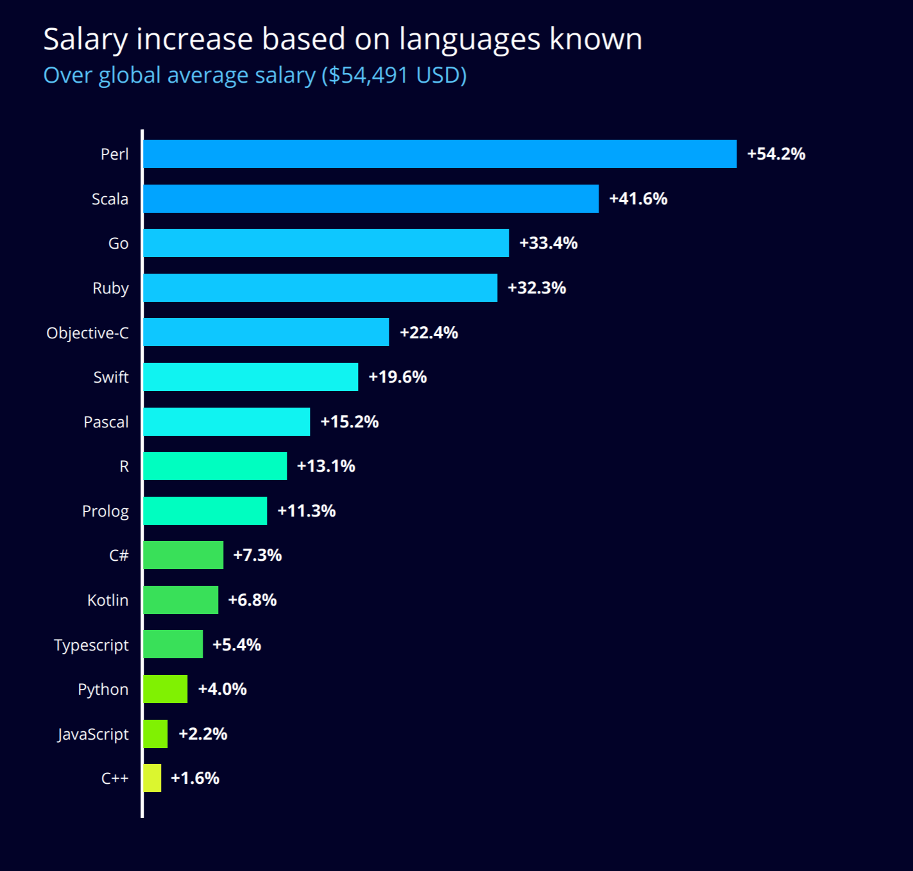
Extra Info on Languages
languages

Slide 33
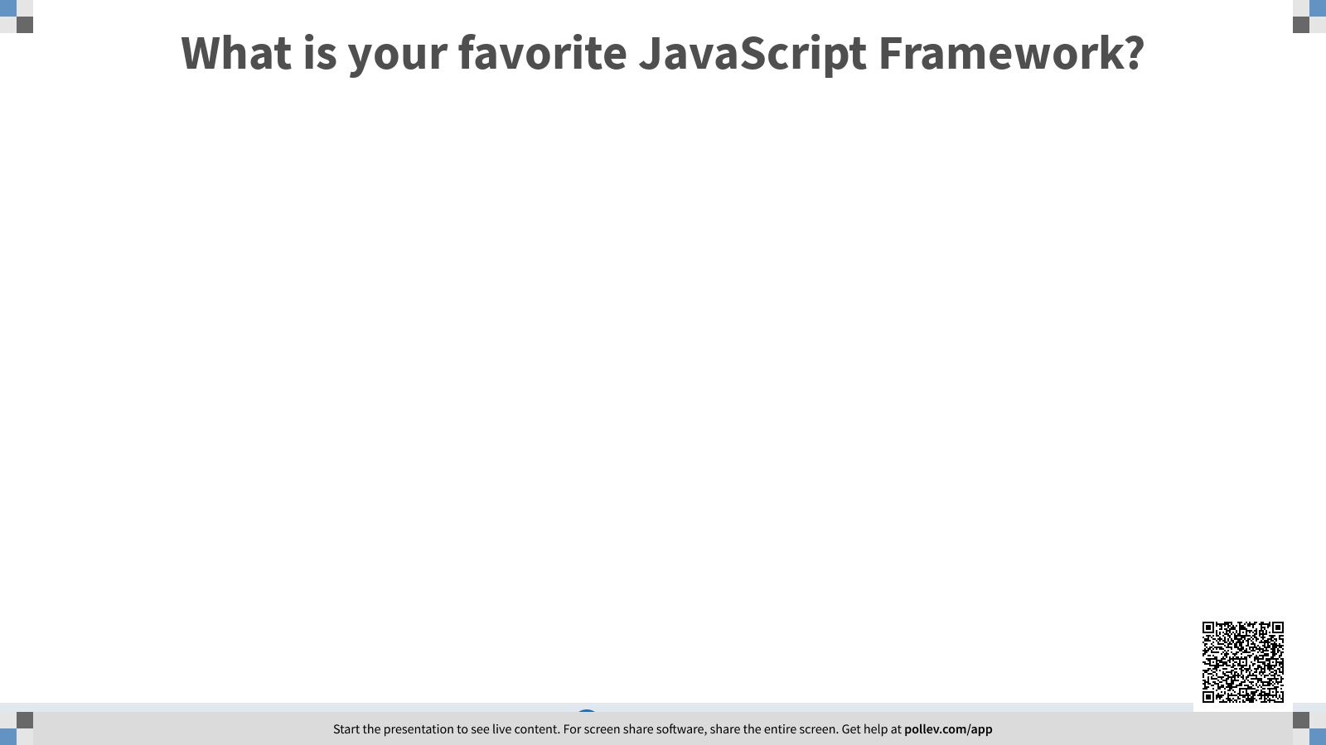

Slide 34
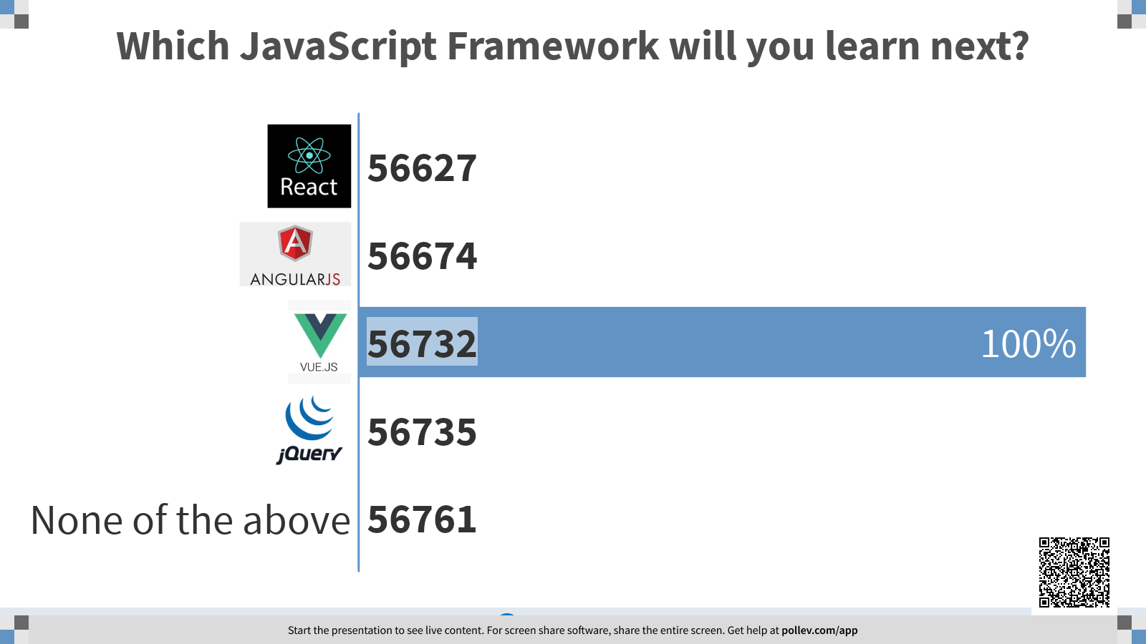

Slide 35
JavaScript “Drinking Game”
Take a dictionary, open it on a random page, and pick a random word.
Now google for “<word>.js”
If its a Javascript library, take a drink.
The winner is the last person to go to the hospital with alcohol poisoning.

Slide 36
Sources
https://www.freecodecamp.org/news/angular-vs-vue-which-is-best-for-programming-in-2020/#:~:text=Angular%20is%20Google's%20advanced%20and,often%20used%20for%20swift%20prototyping.
https://www.codeinwp.com/blog/angular-vs-vue-vs-react/
https://info.hackerrank.com/rs/487-WAY-049/images/HackerRank-2020-Developer-Skills-Report.pdf
https://gist.github.com/tkrotoff/b1caa4c3a185629299ec234d2314e190
https://insights.stackoverflow.com/trends?tags=jquery%2Cangularjs%2Cangular%2Creactjs%2Cvue.js
https://trends.builtwith.com/javascript/jQuery
https://academind.com/learn/javascript/jquery-future-angular-react-vue/
https://vuejs.org/v2/guide/comparison.html
https://www.mindk.com/blog/react-vs-vue/
https://academind.com/learn/angular/angular-vs-react-vs-vue-my-thoughts/

